Slide 1
UAE Banking Customer Satisfaction Analysis A Case Study
Abdulaziz Alrashidi

Slide 2
Executive Summary
Objective
The Master Driver
Key Trends
Recommendation
Analyze UAE banking CSAT survey data to identify the primary drivers of customer satisfaction and uncover key trends across customer segments.
Physical infrastructure factor, which has branch coverage, ATM availability, waiting times, and facility comfort, is the most significant driver of customer satisfaction.
This factor is bi-directional, having the strongest impact on both increasing and decreasing the overall satisfaction compared to other categories.
Customers aged 50+ report lower satisfaction and show a strong preference for in-person service, while younger customers demonstrate higher satisfaction with digital channels.
Customers in their first year consistently report lower satisfaction. Satisfaction improves as the length of the banking relationship increases.
Maintain and optimize physical assets, as they are the highest-impact drivers of satisfaction.
Develop targeted service enhancements for senior customers.
Streamline onboarding processes to improve the first-year customer experience.

Slide 3
Table of Contents
This presentation is divided into the following sections:
Introduction
Methodology
Results
Recommendations
Limitations

Slide 4
Introduction
Customer satisfaction is defined as “the customer’s perception of the degree to which their requirements have been fulfilled.”
It can be measured through several approaches, one of the most common method is structured surveys that quantify satisfaction across multiple aspect by using a scale 1-5
This analysis utilizes data collected from a Customer Satisfaction (CSAT) survey conducted within the UAE banking market.

Slide 5
Introduction
The survey consists of 222 questions covering customer demographics, awareness, product usage, service experiences, and detailed CSAT evaluations across multiple banking aspects.
The primary objective of this analysis :
To identify the most impactful drivers of overall banking satisfaction
To uncover meaningful trends across customer segments
To recommend strategic and actionable insights.

Slide 6
Methodology

Slide 7
Methodology
The methodology of this analysis is empirically driven and was refined iteratively based on insights from preliminary analysis.
The variable “Banking Overall exp CSAT” was selected as the primary holistic indicator metric for satisfaction, based on its semantic meaning and an assumption of its importance.

Slide 8
Methodology: Data Cleaning
The analysis began with cleaning the dataset by removing:
Non-analytical variables
Clearly redundant variables
Duplicate records
Broken or inconsistent variable names
Variables with excessive missingness
Variables with zero or near-zero variance

Slide 9
Methodology: Driver Analysis
To address the driver analysis, only CSAT-related variables were included.
As an initial exploratory step, a correlation analysis was conducted between all variables and the target.
Most variables were tightly correlated with the target. However, the negligible granularity between scores (between 0.01 to 0.1) was insufficient to identify a clear and genuine driver.
This lack of separation made simple ranking unreliable .
Thus, more robust analysis was therefore required.

Slide 10
Methodology: Driver Analysis
To facilitate deeper analysis, survey questions were grouped into five major groups, based on conceptual similarity:
Service and Support: staff behavior, responsiveness, issue resolution
Physical Reach: branch availability, ATM access, waiting times, facility comfort
Digital Experience: mobile app, online banking, digital usability
Product Value: fees, rates, rewards, promotions
Trust and Security: safety, transparency, ethical standards

Slide 11
Methodology: Driver Analysis
To facilitate interpretability, Ordinary Least Squares (OLS) regression was initially used to identify drivers of satisfaction.
However, the model failed due to severe multicollinearity with variation inflation factor (VIF) values ranging from 100–300 and produced illogical coefficients, for example, Trust & Security showing a negative impact.
This indicated that linear models and their variants were unreliable for driver analysis.

Slide 12
Methodology: Driver Analysis
To achieve reliability, robustness, and interpretability, a histogram gradient boosting model was used, supported by permutation importance and SHapley Additive exPlanations (SHAP) values for driver interpretation.
The model was trained using an 80/20 train-test split with 5-fold cross-validation.
It achieved an R² of 0.39 on the training set and 0.37 on the test set.

Slide 13
Methodology: Trend Analysis
To uncover trends, group-by analysis and cross-tabulation were conducted across the following variables:
Age group
Nationality
Region
Income
Account age
Primary bank
Support usage frequency
Preferred service channel
Banking Overall Experience CSAT

Slide 14
Results

Slide 15
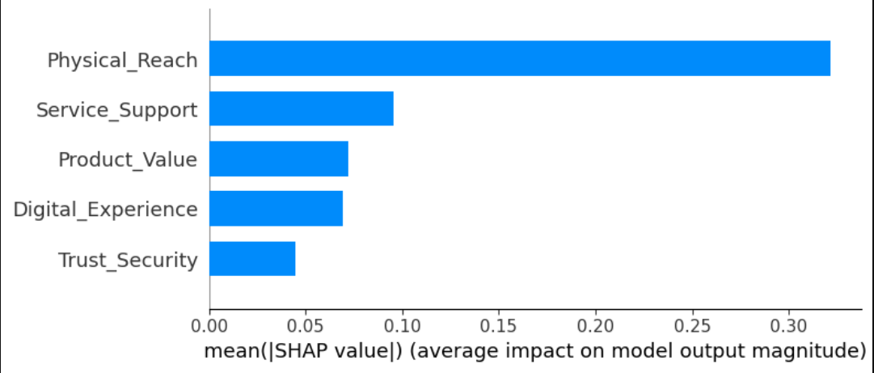
Results: Driver Analysis
Physical Reach (branch, ATMs, comfort) is the most influential driver of satisfaction.
It shows 3x the impact compared to Service Support.

Slide 16
Results: Driver Analysis
The other group showed milder effect on satisfaction. However, there is ranking among them.
Service Support is the second most impactful, with 25%+ compared to other groups.
(staff behavior, responsiveness, issue resolution)

Slide 17
Results: Driver Analysis
Product Value and Digital Experience scored similarly.
Trust and Security is the least influential.

Slide 18
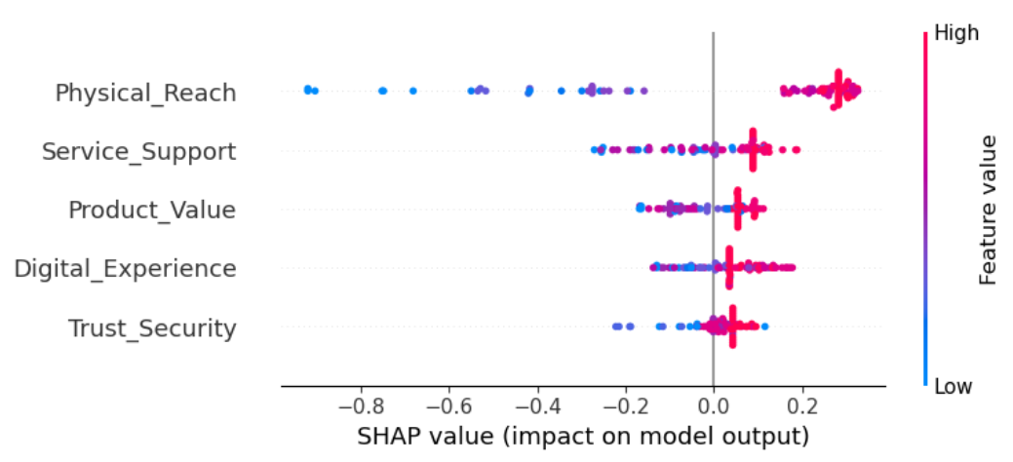
Results: Driver Analysis
Poor Physical Reach is a greatly detrimental to satisfaction (-0.9) .

Slide 19
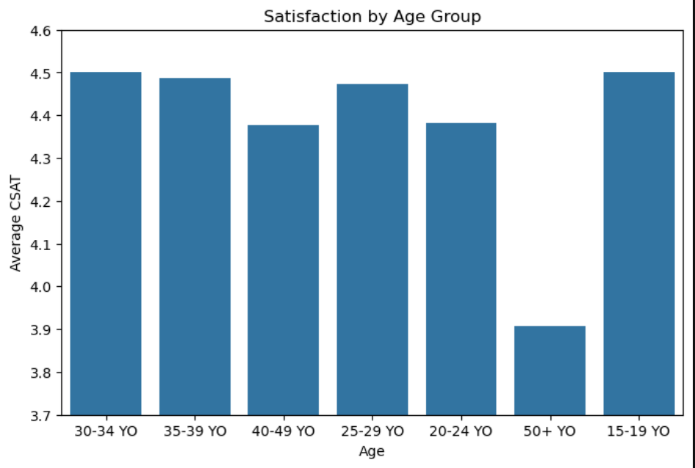
Results: Trend Analysis
Age groups between 15 and 49 reported similar satisfaction scores, with minimal variation between 4.4 and 4.5
However, there is a noticeable decline among senior customers aged 50 and over, with a score of 3.9.

Slide 20
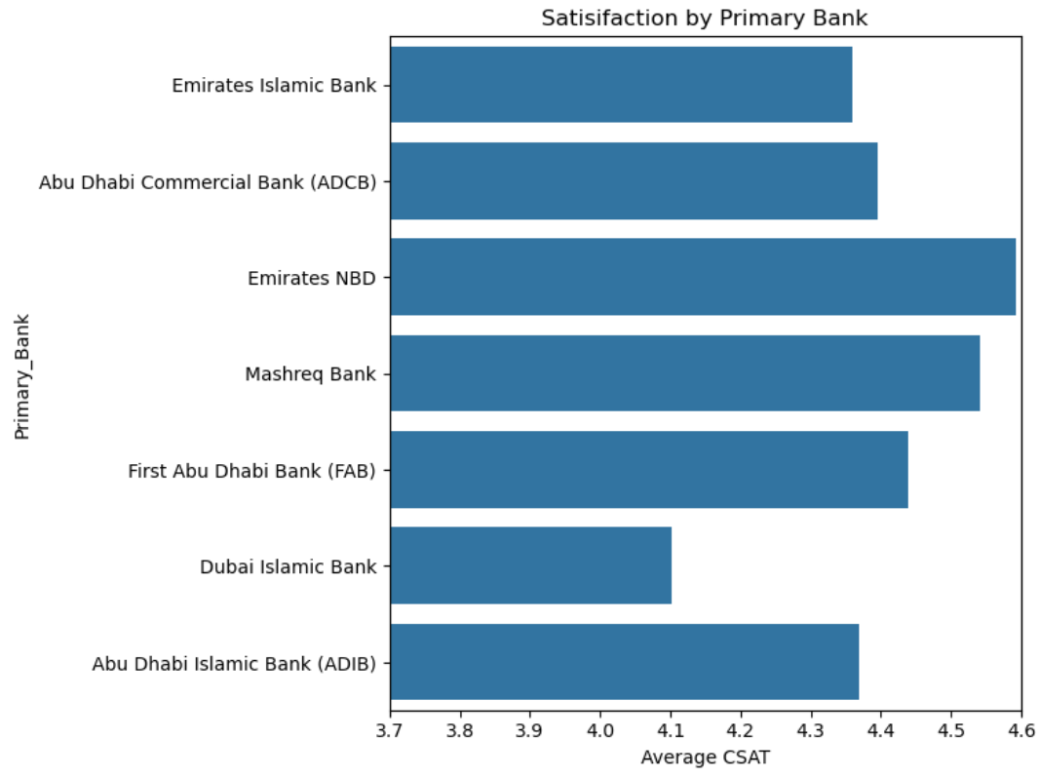
Results: Trend Analysis
Emirates National Bank of Dubai (n=76) achieved the highest satisfaction score at 4.6,
Although Mashreq Bank reported a similar rating, it had a smaller sample size (n=23).

Slide 21
Results: Trend Analysis
Other banks showed similar satisfaction scores, ranging between 4.4 and 4.5.
However, Dubai Islamic Bank reported the lowest score at 4.1 (n=39).

Slide 22
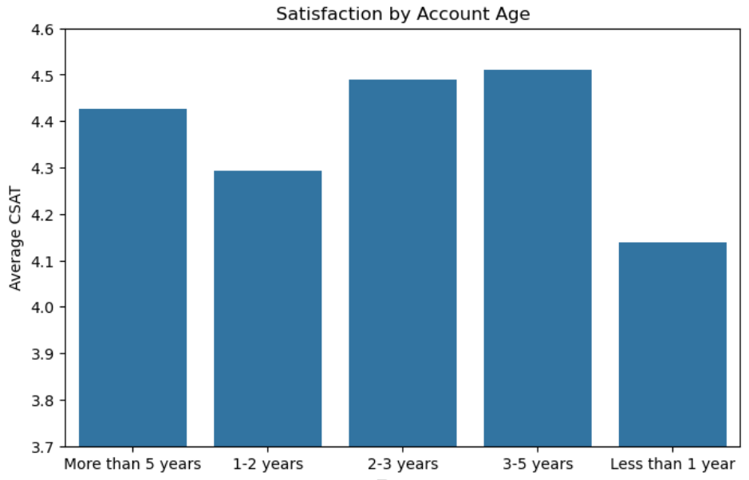
Results: Trend Analysis
Satisfaction levels show a general upward trend as account age increases.
The lowest scores are found among new customers, specifically those with less than one year of , who report 4.1.
Satisfaction is the highest among customers of 2 to 5 years at approximately 4.5, while loyal customers (more than 5 years) show a slight dip to 4.4.

Slide 23
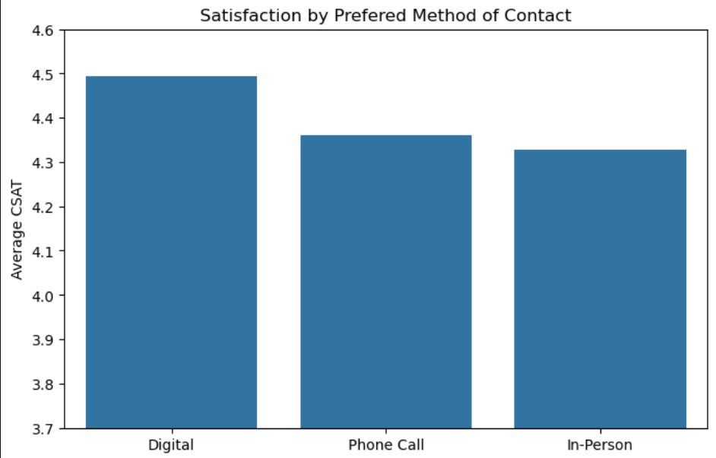
Results: Trend Analysis
Customer satisfaction is highest among those who prefer Digital contact (4.49).
Those who prefer Phone Calls (4.36).
And those who prefer In-Person interactions reported slightly lower satisfaction levels (4.33).

Slide 24
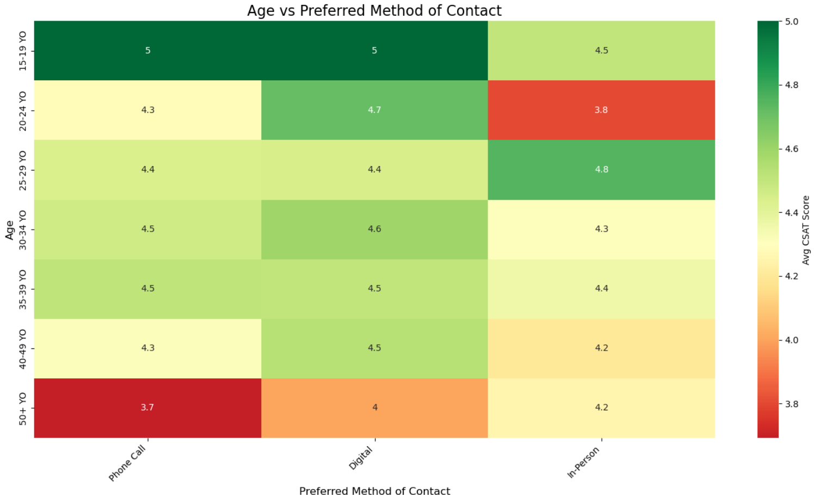
Results: Trend Analysis
A divide exists in channel preferences between age groups.
Younger customers (20–49) report higher satisfaction when using Digital followed by Phone channels, while rating In-Person visits the lowest.
In contrast, Seniors (50+; n=32) show the opposite trend, they are most satisfied with In-Person interactions (4.25) and least satisfied with Phone Calls (3.7).

Slide 25
Actionable Recommendations

Slide 26
Recommendations
Protect and maintain the Master Driver (Physical Reach): Prioritize branch and ATM availability and reduce waiting times. Maintaining these "Physical Reach" factors is critical to protect the strongest driver of satisfaction.
Design and implement targeted improvements for senior customers, focusing on enhancing the experience within their preferred In-Person channels.
Simplify and streamline the early-stage customer experience to improve the satisfaction gap seen in the first 12 months of the account age.
Maintain and improve staff responsiveness and issue resolution. Service & Support remains a significantly stronger driver of satisfaction (25%+) compared to Product or Digital groups.

Slide 27
Limitations

Slide 28
Limitations
Lack of survey metadata and documentation:
A key limitation of this analysis is that the dataset lacks metadata or documentation explaining how the survey questions were designed and what they represent.
As a result, the “Banking overall exp CSAT numeric” target was treated at face value as the primary measure of satisfaction, and the analysis was built around it.
However, this target variable may not fully capture the underlying reasons behind customer experience or the true meaning intended by the researcher.
Therefore, the insights and results of this analysis may be impacted by this uncertainty.

Slide 29
Limitations
Self-reporting bias in survey data:
This dataset is derived from a survey-based study. Such responses are prone to self-reporting bias, where psychological, emotional, subjective, and personal prejudices may affect the accuracy of the scores.
As a result, the reported satisfaction levels may not perfectly reflect real-world experiences or objective service quality.
Therefore, findings based on this data should be interpreted carefully, and any strong decisions should be supported by supplementary data or further analysis.

Slide 30
Limitations
Model explanatory power (R2) :
The Histogram Gradient Boosting model used for this analysis achieved an R2 of 0.37 on the test set.
This indicates that while the identified drivers are significant, approximately 63% of the variation in customer satisfaction remains unexplained by the variables included in this study.
Such a result is common in survey data, but it suggests that external factors may also play a stronger role in affecting satisfaction.
Therefore, the five driver groups should be viewed as primary internal influencers rather than an exhaustive list of all factors affecting customer experience.

Slide 31
Thank You!

